Slide 1
Delay Status Update
10/16/14

Slide 2
Additive Noise
System:
X(n) = AX(n-1) + W(n-1)
Y(n) = CX(n) + W(n)
Solution: Kalman Filter
Comments:
Red = Linear memoryless estimator
Blue = Kalman Filter
If VarW = 0, VarV → 0 as n → ∞

Slide 3
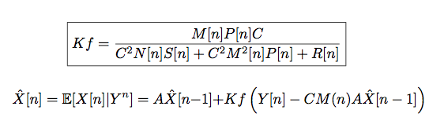
Multiplicative Noise
System:
X(n) = AX(n-1) + W(n-1)
Y(n) = C(n)X(n) + W(n)
Solution: Linear Estimator (Rajasekaran)
Comments
Blah

Slide 4
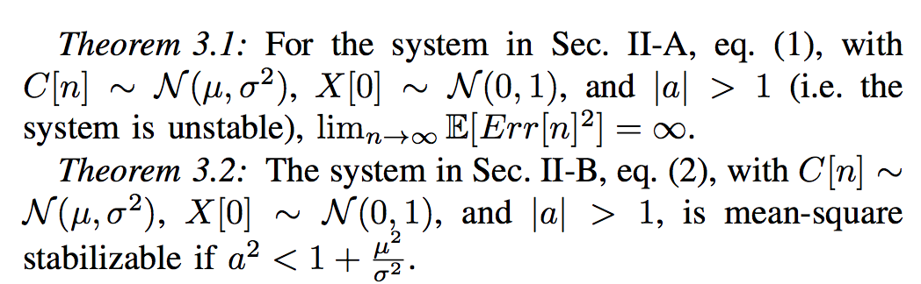
Non-Coherence Control vs Estimation

Slide 5
“X” Delay Estimation
Multiplicative Noise + Packet Drops
System:
X(n) = AX(n-1) + W(n-1)
Y(n) = C(n)X(n) + V(n)
Implementation
Comments:
Delay → Sawtooth shape
Drops → Approaching no information
Add Noise → Packets become more important
Mul Noise → Packets become less important
X
V(n)
P
Y
C(n)
Sys
Enc
Dec
k…
Xhat

Slide 6
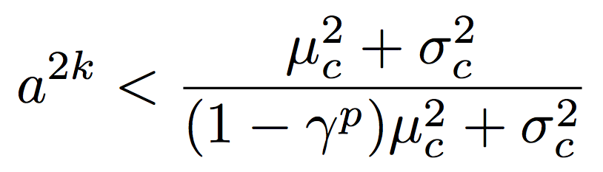
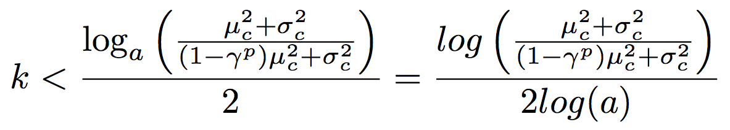
“X” Delay Control
System:
X(n) = AX(n-1) + W(n-1) + U(n)
Y(n) = C(n)X(n) + V(n)
Comments:
No drops + A < 1 → controller increases variance
Parameters I can change: A, C(n), K, Gamma (Drop P)
Flexibility of all parameters drops significantly!!
X
V(n)
P
Y
C(n)
Sys
Enc
Dec
U(n)
k…

Slide 9
“Y” Delay Estimation
Same as Linear Estimator with Multiplicative Noise and Prediction (just multiply by A^k)

Slide 10
“Y” Delay Control
System:
X(n) = AX(n-1) + W(n-1) + U(n)
Y(n) = C(n-k)X(n-k) + V(n-k)
Comments
Information comes in pairs
If there’s only state noise amount of delay = amount of delay between used observations
Difficulty in computing additive noise because it’s compounded at each timestep
X
V(n)
P
Y
C(n)
Sys
Enc
Dec
k…
Xhat

Slide 11
Moving Forward
Learning Crand? Reinforcement learning?
“Y” Delay + “U” Delay

